Slide 2
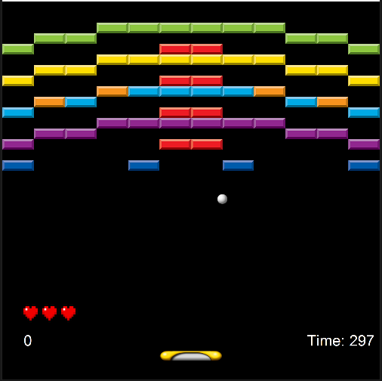
SU 2022
Examination Presentation
Aditya Fadhillah

Slide 3
Iterative Process
Load text file maps into game levels
Block entities
A moveable player
A moveable ball
A state machine
Points
Special block type
Winning and losing
Game over
Power-up blocks and effect
10 main implementations
Reminiscence of agile development
Analysis, Design, Implementation and Testing

Slide 4
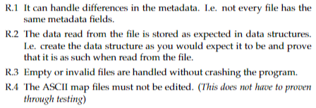
Analysis
Requirements
Example: LevelLoader

Slide 5
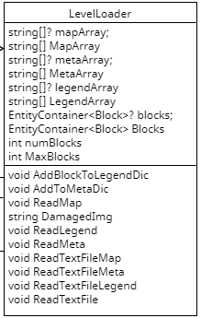
Design
Design pattern
Example: LevelLoader
Builder
Chain of Responsibility

Slide 6
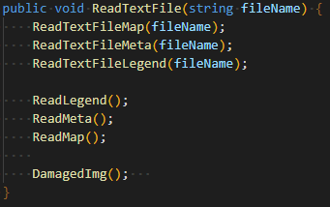
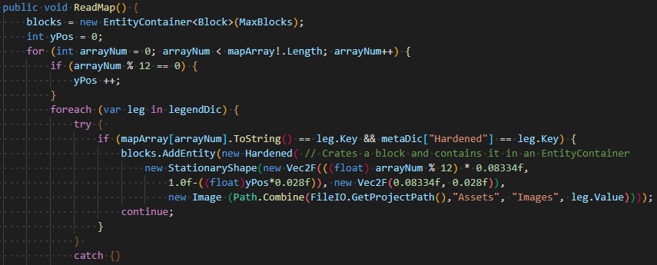
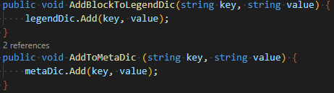
Implementation
Implementation
Example: LevelLoader
Methods & Dictionaries

Slide 7
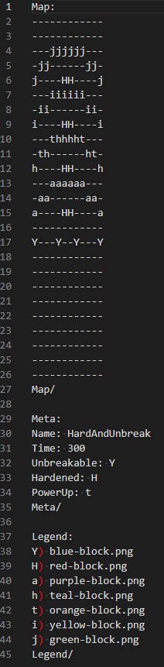
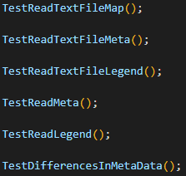
Test
56 total test cases
Low branch coverage
Decent method coverage
Example: LevelLoader

Slide 8
Evaluation: Result
A game that runs as expected
Meet all the requirements (for the most part, speed of ball)
Design goals as an after thought
All test passed, but it is not an extensive enough testing

Slide 9
Evaluation: Problems and Challenges
Reads and analyze the requirements before tackling it
Design of the system is not taken into concideration in the beginning.

Slide 10
Evaluation: Improvements
Design goals as a priority from the beginning
Interface Segregation Principle

